Slide 1
While we are waiting:
Join the APUSH Summer Remind group by texting the following message to 81010:
@fhk934b
This will only be used to send announcements to students regarding class information

Slide 2
Textbook – 16th ed. Can find used on Amazon for $50-160 Books can be checked out from the Library starting Thursday June 13. (will provide date via Remind) - During Lunch or After School Only There is no online textbook available

Slide 3
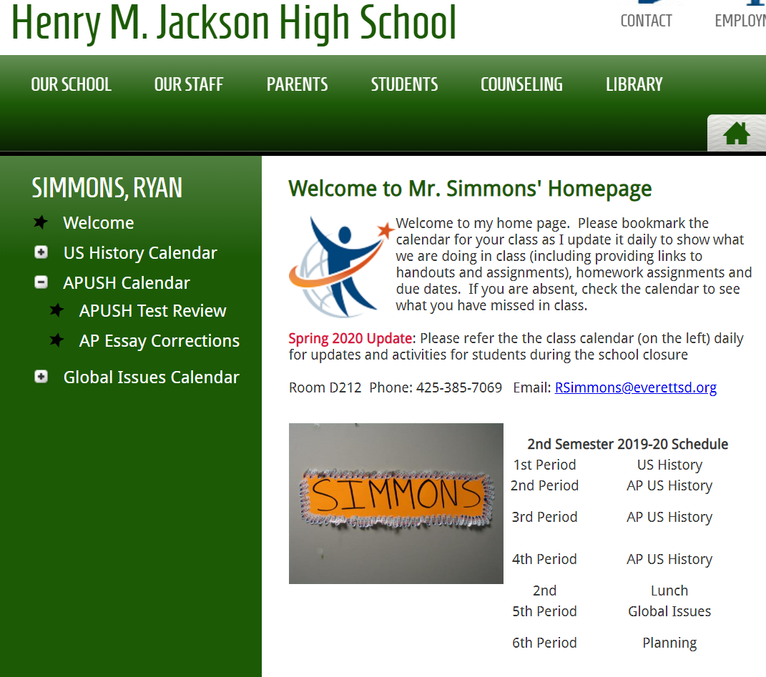
My Webpage
This will be your online point of contact for the duration of the course.
I will also use Google Classroom for submission of some assignments. Individual classes by period will be set up in the fall.

Slide 4
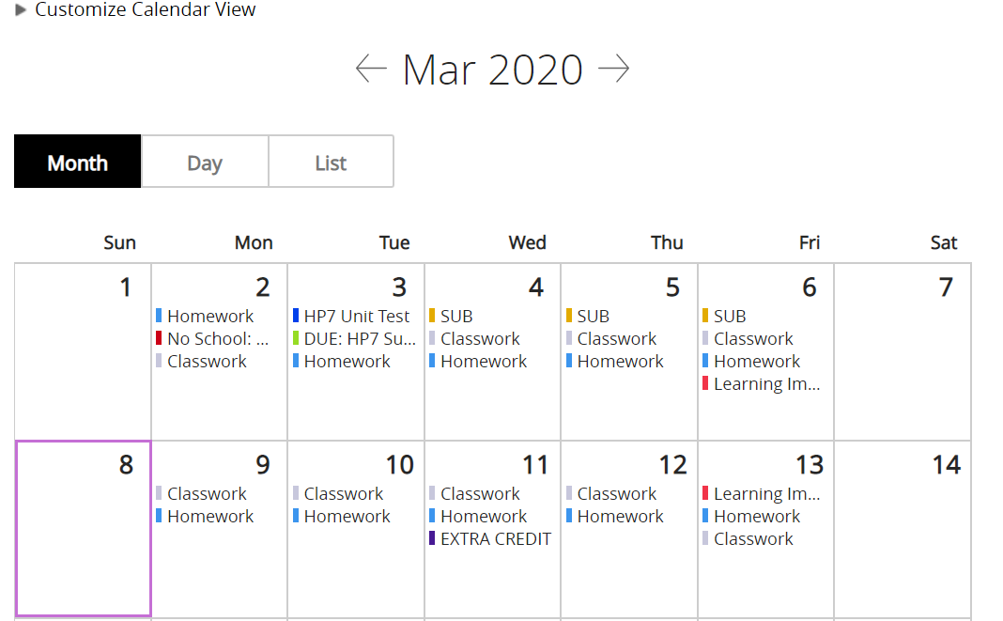
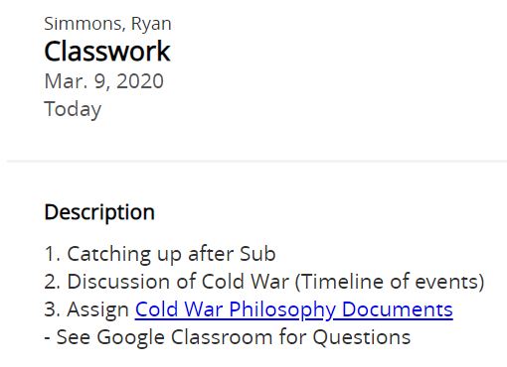
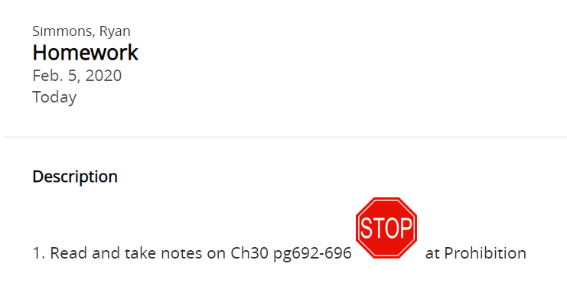
My Calendar
Classwork
Homework
Due Dates
Etc.

Slide 5
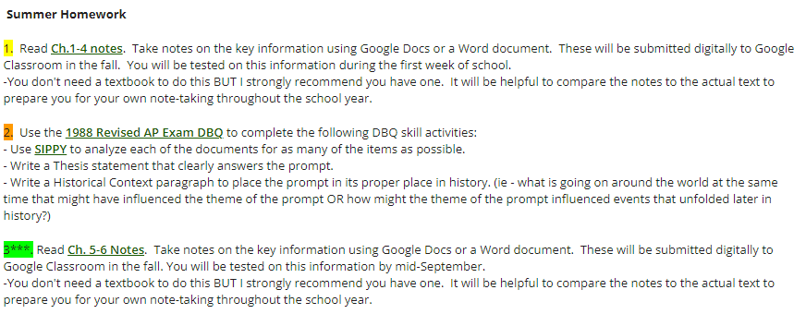
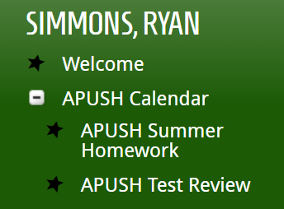
Summer Homework

Slide 6
Additional Resources
The Test Review link has a variety of resources including course handouts, textbook resources, writing rubrics and additional online resources you may find useful

Slide 7
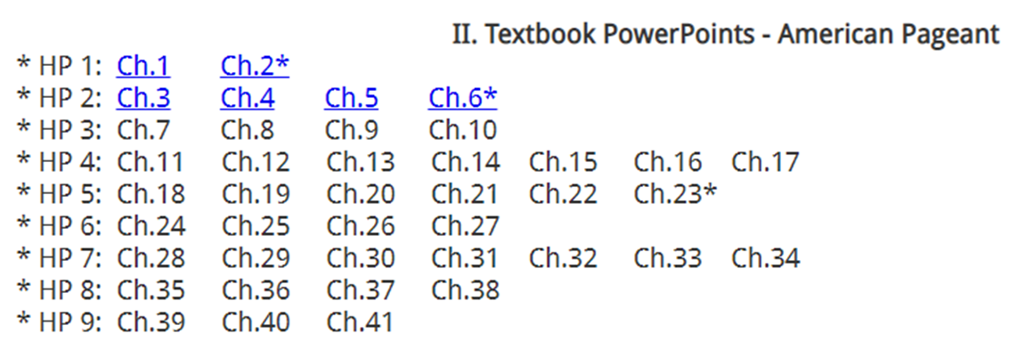

Slide 8
QUESTIONS?? If you haven’t already:
Join the APUSH Remind group by texting the following message to 81010:
@fhk934b

